Slide 1
Testing

Slide 2
Lesson Objectives
Discuss the importance of a complete test suite
Define the differences between unit, integration, and end-to-end testing
Create unit tests to achieve a specified code coverage level
Utilize fixtures and mocks to implement unit tests

Slide 3
Why Test?
Why is testing important?

Slide 4
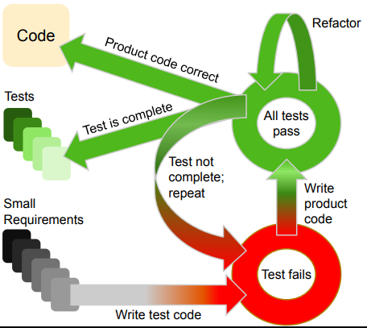
Test Driven Development
Different mindset of software development
Requirements → tests → code
Typically done in red-green-refactor phases
Write a failing test
Write code until the test passes
Refactor the code to cleanup

Slide 5
Testing Types
Functional
Unit tests
Integration tests
End-to-end tests
Acceptance
Non-functional
Security
Performance
Usability
Compatibility

Slide 6
Unit Tests

Slide 7
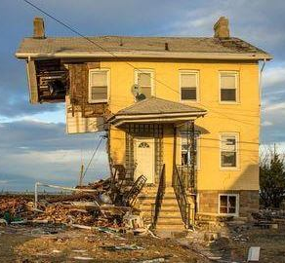
Unit Testing
Is your house stable if the lumber is rotted?
Smallest piece of testable code : unit
Benefits
Helps ensure correctness
Catch problems early
Fast

Slide 8
Unit Testing / Reqts. Framework
Given – When – Then
Given: The initial conditions / prerequisites
When: The action or event to be verified
Then: The outcomes of the action or event
Useful for formulating unit tests based on requirements
Used to communicate with non-technical stakeholders
Keep tests small!!

Slide 9
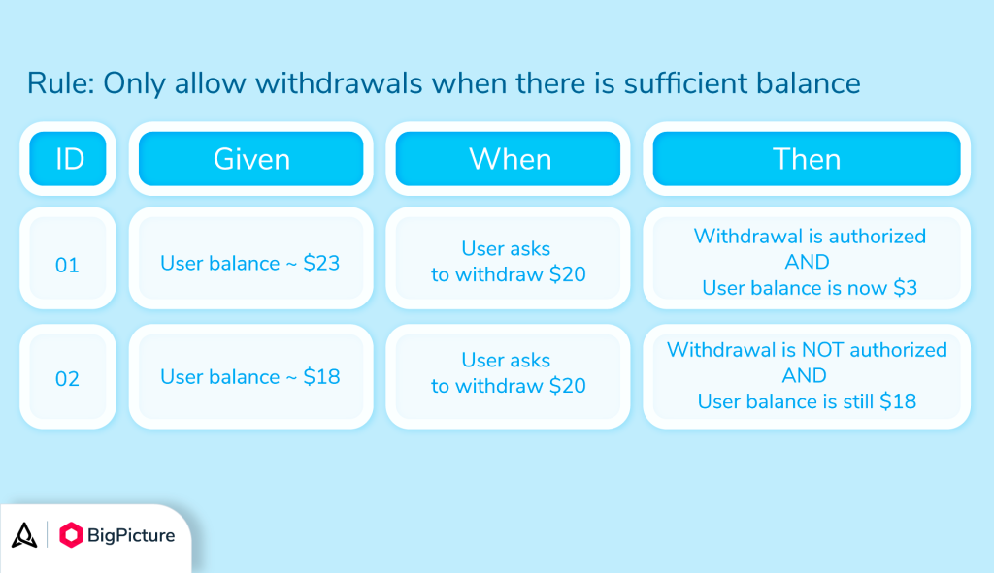

Slide 10
Testing in Python
def add(a, b):
return a + b
def test_add():
assert add(1, 2) == 3
assert add(0, 5) == 5
def test_add_negative():
assert add(-5, -7) == -12
assert add(-5, 5) == 0
Pytest / unittest / doctest
Each has their own pros/cons
Assert statement
Notes:
How would you write “given, when, then” for the code on the right?

Slide 11
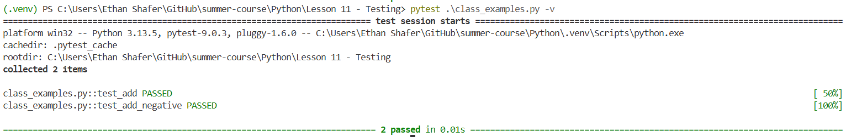
PyTest
def add(a, b):
return a + b
def test_add():
assert add(1, 2) == 3
assert add(0, 5) == 5
def test_add_negative():
assert add(-5, -7) == -12
assert add(-5, 5) == 0
A separate package / command
Generally auto-discovers tests
Can also give specific files
pip install pytest
pip install pytest-cov

Slide 12
Pytest Example
Temperature conversion
Scenario 1
Given a temperature of 0C
When I convert to F
Then I should get 32F
Scenario 2
Given a temperature of 100C
When I convert to F
Then I should get 212F
Scenario 3
Given a temperature of -40C
When I convert to F
Then I should get -40F
Scenario 4
Given a temperature of -300C
When I convert to F
Then I should get an error!

Slide 13
Hands-On #1

Slide 14
Other Testing Ideas

Slide 15
Completeness
Control flow statements create branches
Are we covering every branch?
How much coverage is appropriate?

Slide 16
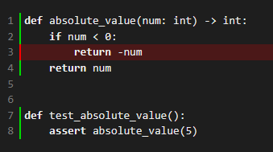
Small Example
def absolute_value(num: int) -> int:
if num < 0:
return -num
return num
def test_absolute_value():
assert absolute_value(5)

Slide 17
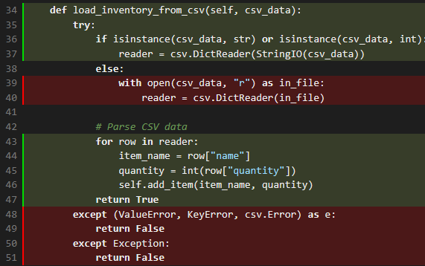
Larger Example
Inventory class
pytest --cov=inventory --cov-report=term-missing --cov-report=html
What's hiding in this coverage?
Notes:
Line 36 of inventory.py might be "covered" but you need to be careful about the 'or' statement

Slide 18
DRY
Fixtures

Slide 19
Mocking External References
Intro to mocks

Slide 20
Integration Tests

Slide 21
Integration tests

Slide 22
Questions

